Slide 1
Data Engineering 1 Term project 2
Team Manila:
Haaris Cheema
Muhammad Talha Zahid
Peter Endes-Nagy
Sabina Umarova

Slide 2
Executive summary
Research question:
Exploring the relationship between suicides rates and the GDP per capita as well as the unemployment rate in a country
Extraction of data from two sources:
1. World Health Organisation
2. World Development Indicators
Utilization of 3 methods:
1. MySQL
2. R
3. API in Knime
Results:
1. Correlation
2. Regressions
3. Scatterplots

Slide 3
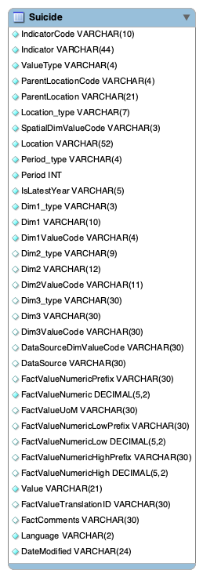
MySQL – Suicides data
Downloaded suicides data from
World Health Organisation
Transformed data into .SQL format with Freeware software
Created table Suicides
Dropped unnecessary columns
Exported data into Knime using MySQL connector node
EER Diagram

Slide 4
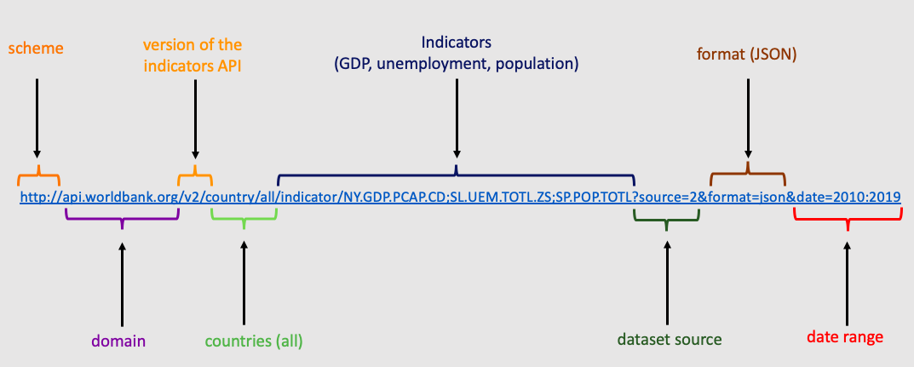
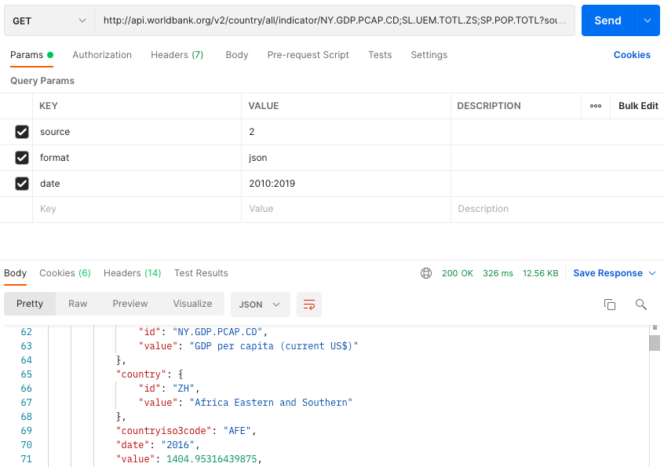
World Bank API
Requested GDP, population, unemployment using WBD API
Checked the validity of the request using Postman
Got results in JSON format
Transformed JSON files into tables in Knime
WB API URL Breakdown
Postman result

Slide 5
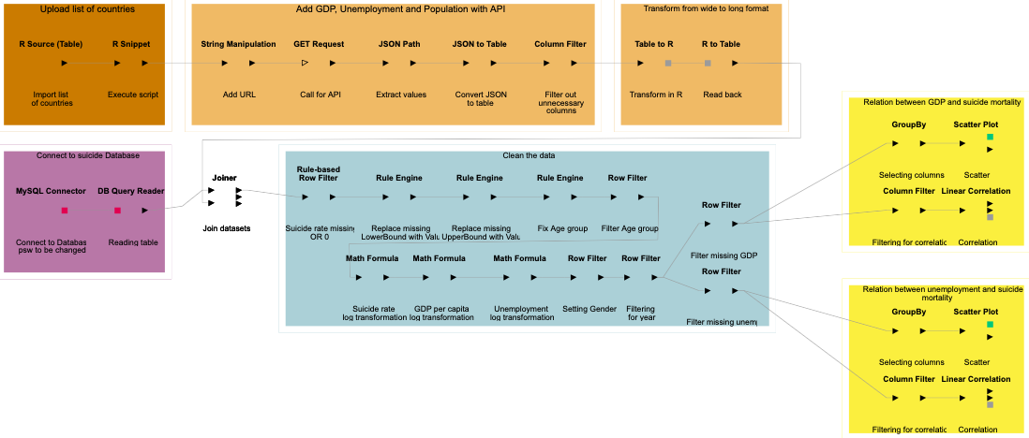
Knime Workflow
Got list of countries
using R Source
Loaded data with API and SQL
Joined data
Cleaned data
Ran analytics

Slide 6
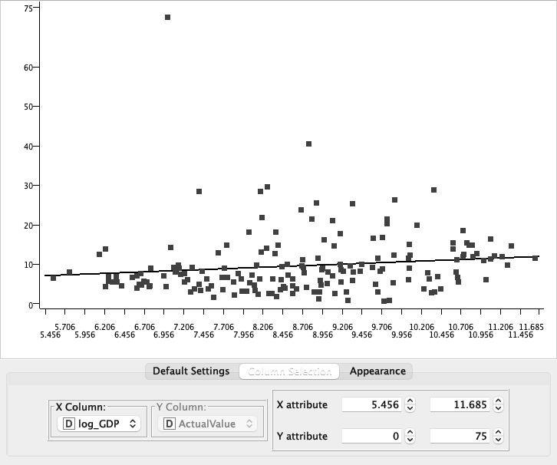
Regressing GDP per capita against suicide mortality
Level – log Regression (Regress suicide rate on log GDP per capita. Year: 2019, both sexes ) [R-Squared: 0.0191]
Variable | Coefficient | Standard Error | t - value | p - value
log_GDP | 0.79 | 0.42 | 1.85 | 0.067
Intercept | 2.70 | 3.77 | 0.72 | 0.475
Weak model
Positive coeff, insignificant at 5%
Surprising: positive
Economic deprivation leading to suicide depends on peer group – GDP per capita inappropriate measure. Diff?

Slide 7
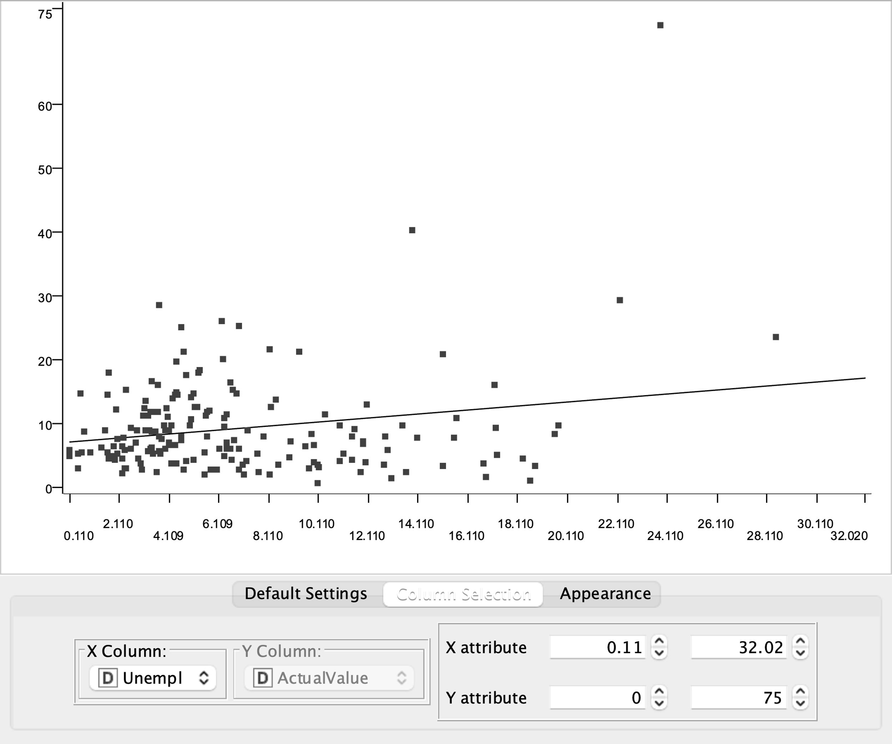
Regressing unemployment rate against suicide mortality
Level – Level Regression (Regress suicide rate on unemployment rate.Year: 2019, both sexes ) [R-squared : 0.042]
Variable | Coefficient | Standard Error | t - value | p - value
Unemployment | 0.31 | 0.11 | 2.79 | 0.006
Intercept | 7.19 | 0.96 | 7.46 | 3.73E-12
Weak model
Positive coeff, significant at 5%
Positive as expected, BUT mainly because of extreme values

Slide 8
Any Questions?

